Slide 1
Relational Database Model Terminology

Slide 2
Agenda
Relational Database Model Terminology
Integrity Constraints
Domain Integrity Constraints
Entity Integrity Constraints
Referential Integrity Constraints
Relational Model Keys
Example Relations

Slide 3
Relational Model Terminology
Column /
Attribute /
Field
Student_ID | First_Name | Department | Phone | Address
100 | Ahmad | IS | 0786778899 | Khost
101 | Shaheen | IT | 0700800900 | Khost
102 | Mohsin | IT | 0777885885 | Paktika
103 | Kamal | IS | 0765889944 | Khost
104 | Rahim | IS | 0799454545 | Logar
105 | Rashid | IT | 0789123456 | Nangarhar
Attributes
Relation/
Table/
File
Rows / Tuples /
Records

Slide 4
Equivalent Sets of Terms
Table | Row | Column
File | Record | Field
Relation | Tuple | Attribute

Slide 5
Integrity Constraints
We have defined three constraints so far in our discussion:
The domain integrity constraint
The entity integrity constraint
The referential integrity constraint
The purpose of these three constraints, taken as a whole, is to create database integrity, which means that the data in our database will be useful, meaningful data.

Slide 6
The Domain Integrity Constraint
It means that all of the values in a column are of the same kind.
The term domain means a grouping of data that meets a specific type definition.
Student_ID | First_Name | Department | Phone | Address
100 | Ahmad | IS | 0786778899 | Khost
101 | Shaheen | IT | 0700800900 | Khost
102 | Mohsin | IT | 0777885885 | Paktika
103 | Kamal | IS | 0765889944 | Khost
104 | Rahim | IS | 0799454545 | Logar
105 | Rashid | IT | 0789123456 | Nangarhar
Domain

Slide 7
The Entity Integrity Constraint
Each row must have a unique data value indicated with a primay or composite key.
It is a fundamental requirement for the proper functioning of a relational database.
Student_ID | First_Name | Department | Phone | Address
100 | Ahmad | IS | 0786778899 | Khost
101 | Shaheen | IT | 0700800900 | Khost
102 | Mohsin | IT | 0777885885 | Paktika
103 | Kamal | IS | 0765889944 | Khost
104 | Rahim | IS | 0799454545 | Logar
105 | Rashid | IT | 0789123456 | Nangarhar
Unique values

Slide 8
The Referential Integrity Constraint
If a value of one attribute of a relation references a value of another attribute in another relation, then the referenced value must exist.
It states that the table relationships must always be consistent.
Student Relation
Std_ID | First_Name | Dept | Phone | Address
100 | Ahmad | IS | 0786778899 | Khost
101 | Shaheen | IT | 0700800900 | Khost
102 | Mohsin | IT | 0777885885 | Paktika
103 | Kamal | IS | 0765889944 | Khost
104 | Rahim | IS | 0799454545 | Logar
105 | Rashid | IT | 0789123456 | Nangarhar
Course Relation
Std_ID | Course Title | Credits
100 | Database Fundamentals | 5
100 | Java Programming | 4
100 | Multimedia | 5
100 | Web Designing | 4
100 | Islamic Culture | 4

Slide 9
Relational Model Keys
A key is one or more columns of a relation that is used to identify a row.
A key can be unique or nonunique.
Types of Keys
Surrogate Key
Composite Key
Candidate Key
Primary Key
Foreign Key

Slide 10
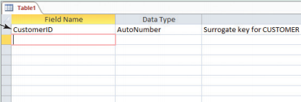
Surrogate Key
A surrogate key is a column with a unique, DBMS-assigned identifier that has been added to a table to be the primary key.
The unique values of the surrogate key are assigned by the DBMS each time a row is created, and the values never change.
Surrogate Key

Slide 11
Composite Key
A key that contains two or more attributes is called a composite key.
For example, suppose that we are looking for a unique key for the EMPLOYEE relation, and the users say that although LastName is not unique, the combination of LastName and Department is unique.
Thus, for some reason the users know that two people with the same last name will never work in the same department. Two Johnsons, for example, will never work in accounting.
If that is the case, then the combination (LastName, Department) is a unique composite key.

Slide 12
Candidate and Primary Keys
Candidate keys are keys that uniquely identify each row in a relation. Candidate keys can be single-column keys, or they can be composite keys.
The primary key is the candidate key that is chosen as the key that the DBMS will use to uniquely identify each row in a relation.
For example, suppose that we have the following EMPLOYEE relation:
Emp_No | FirstName | Department | Phone | Email
200 | Elham | Sales | 0786778899 | elham@gmail.com
201 | Omid | Accounting | 0700800900 | omid@yahoo.com
202 | Malyar | Sales | 0777885885 | malyar@live.com
203 | Kabir | HR | 0765889944 | kabir@hotmail.com
204 | Khalid | Marketing | 0799454545 | khalid@gmail.com

Slide 13
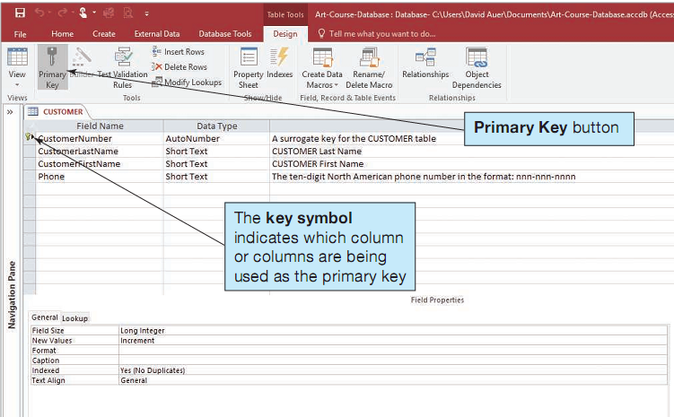
Defining a Primary Key in MS Access

Slide 14
Foreign Key
We place values from one relation into a second relation to represent a relationship.
The values we use are the primary key values of the first relation.
When we do this, the attribute in the second relation that holds these values is referred to as a foreign key.
STUDENT Relation
Primary Key
Std_ID | First_Name | Dept | Phone | Address
100 | Ahmad | IS | 0786778899 | Khost
101 | Shaheen | IT | 0700800900 | Khost
102 | Mohsin | IT | 0777885885 | Paktika
103 | Kamal | IS | 0765889944 | Khost
104 | Rahim | IS | 0799454545 | Logar
105 | Rashid | IT | 0789123456 | Nangarhar
Foreign Key
COURSE Relation
Std_ID | Course Title | Credits
100 | Database Fundamentals | 5
100 | Java Programming | 4
100 | Multimedia | 5
100 | Web Designing | 4
100 | Islamic Culture | 4

Slide 15
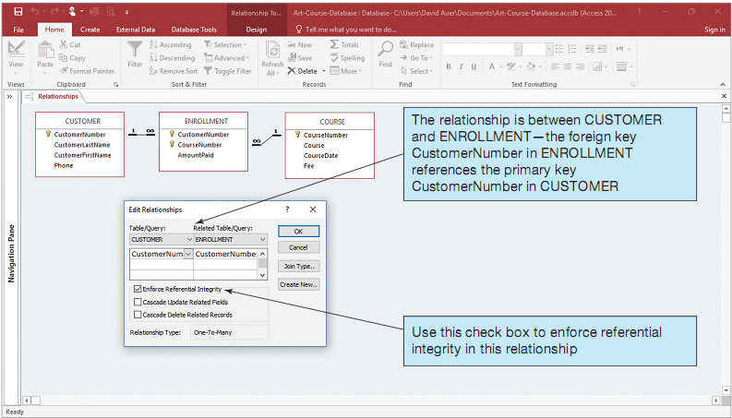
Enforcing Referential Integrity in MS Access

Slide 16
Thank You!

